Slide 1

BRACT’s Vishwakarma Institute of Information Technology Artificial intelligence and Data Science
ADUA31202: Design and analysis of algorithm
A Project On
Applications of Backtracking algorithm
Roll No. | PRN | Name of student
373059 | 22210161 | Sejal Tongire
373062 | 22210530 | Shreyash S. Vachkal
373065 | 22211394 | Nishant N. Wankhede
373073 | 22320146 | Purushottam S. Habib

Slide 2
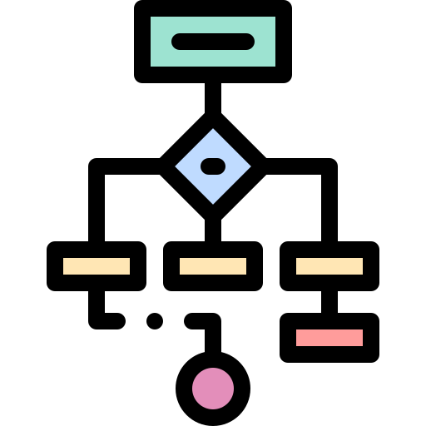
Design and Analysis of Algorithms: A Web-Based Project
This web-based project explores the fundamentals of design and analysis of algorithms, showcasing the implementation of three key algorithmic concepts: Sudoku solver, N-Queens problem visualizer, and Tic-Tac-Toe game.

Slide 3

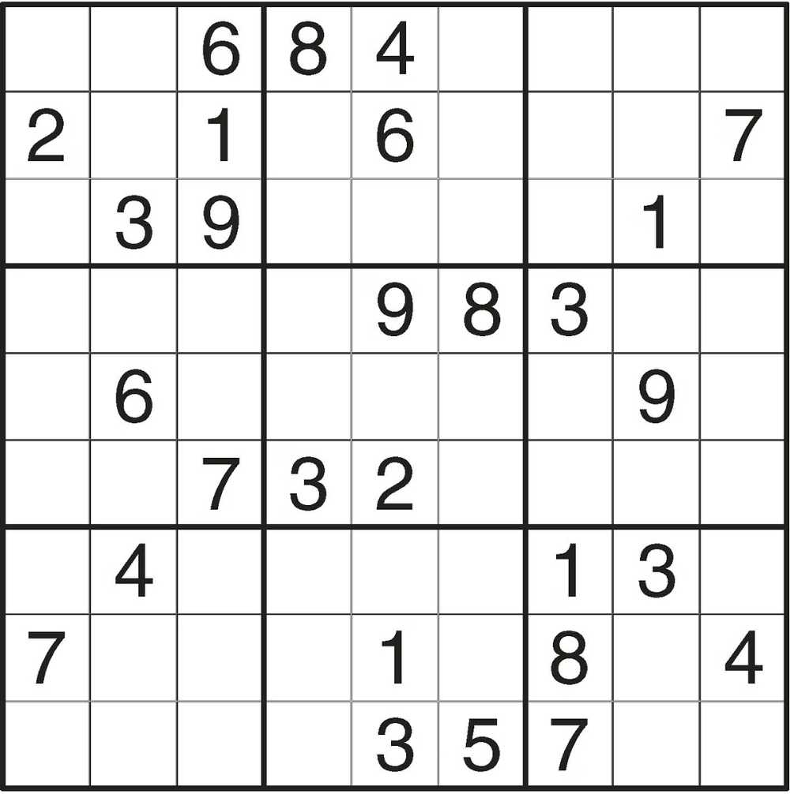
Sudoku Solver
1
Problem Analysis
Understand the rules and constraints of the Sudoku puzzle.
2
Backtracking Algorithm
Implement a backtracking algorithm to systematically solve the Sudoku puzzle.
3
User Interface
Design an intuitive web interface for users to input and visualize the Sudoku solution.

Slide 4
Backtracking Algorithm for Sudoku
Recursive Approach
Constraint Checking
Backtracking Mechanism
The backtracking algorithm uses a recursive function to explore all possible solutions.
The algorithm checks the row, column, and 3x3 grid constraints to ensure a valid solution.
When a dead end is reached, the algorithm backtracks to the previous step and tries a different option.

Slide 5

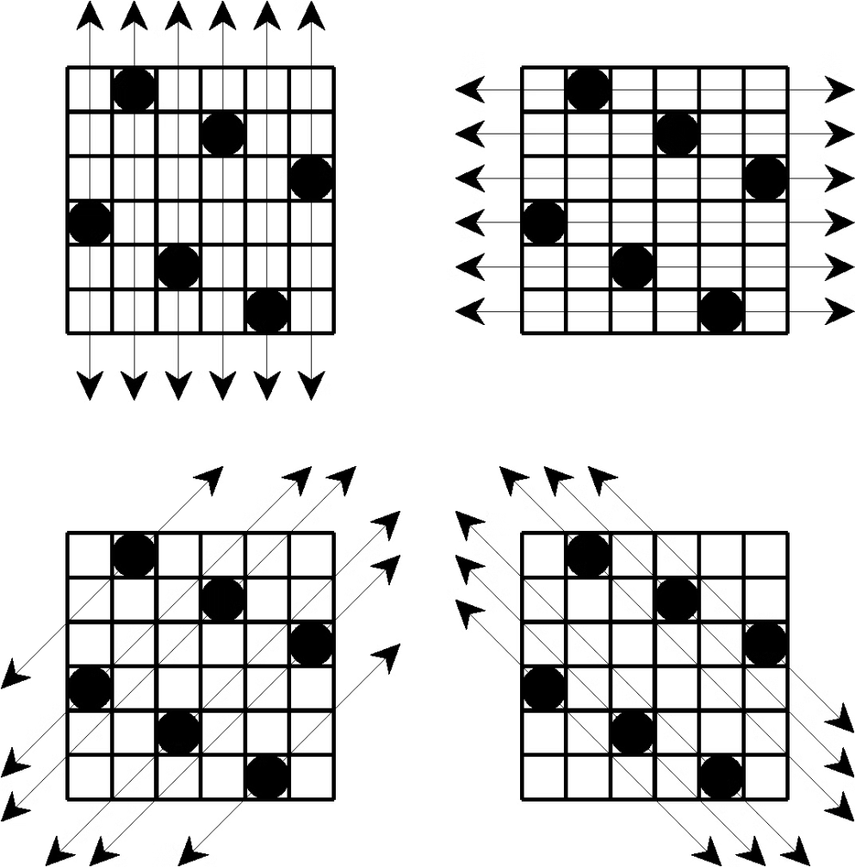
N-Queen Problem Visualizer
Complexity
Placement Strategies
The N-Queens problem is a classic backtracking algorithm with a time complexity of O(n!).
The algorithm must strategically place queens on the chessboard without any conflicts.
Visualization
Educational Value
The web-based visualizer allows users to explore different solutions and understand the problem better.
The N-Queens visualizer serves as an engaging learning tool for students studying algorithms.

Slide 6


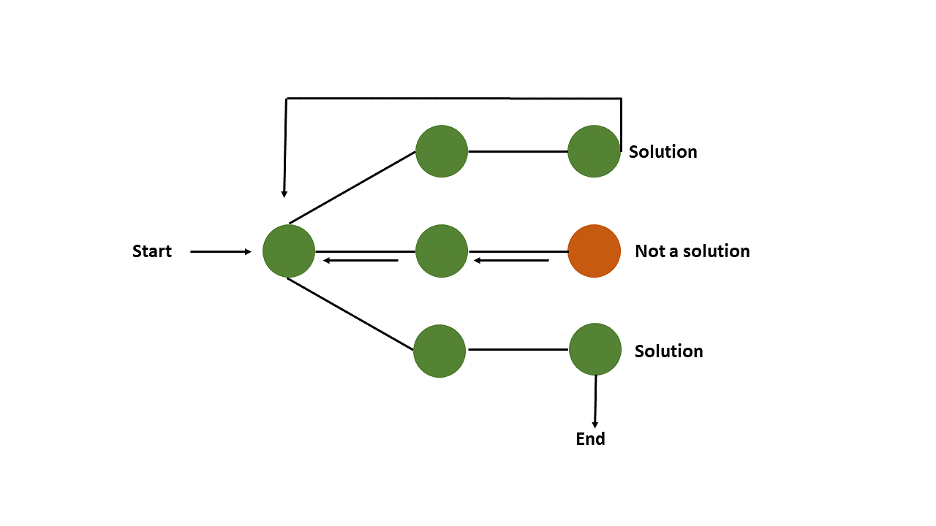
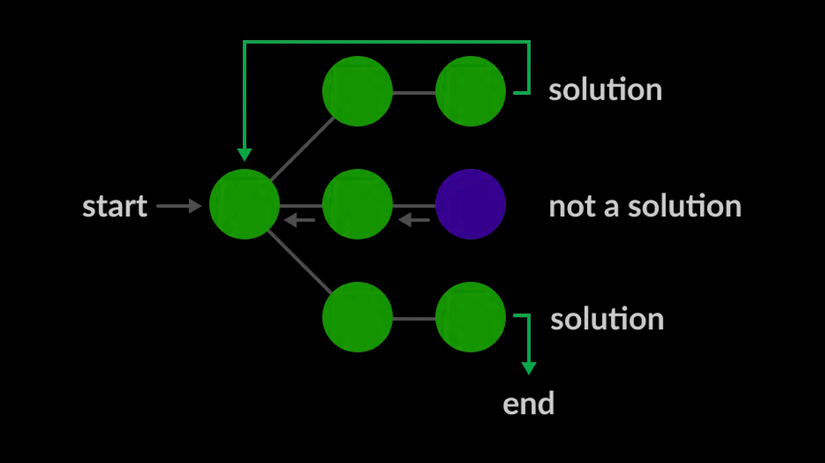



Backtracking Algorithm for N-Queens
Place Queen
The algorithm starts by placing a queen in the first column.
Check Conflicts
It then checks if the queen placement is valid, considering rows, columns, and diagonals.
Recursive Call
If the placement is valid, the algorithm recursively places queens in the remaining columns.
Backtrack
If a placement is invalid, the algorithm backtracks to the previous step and tries a different option.

Slide 7
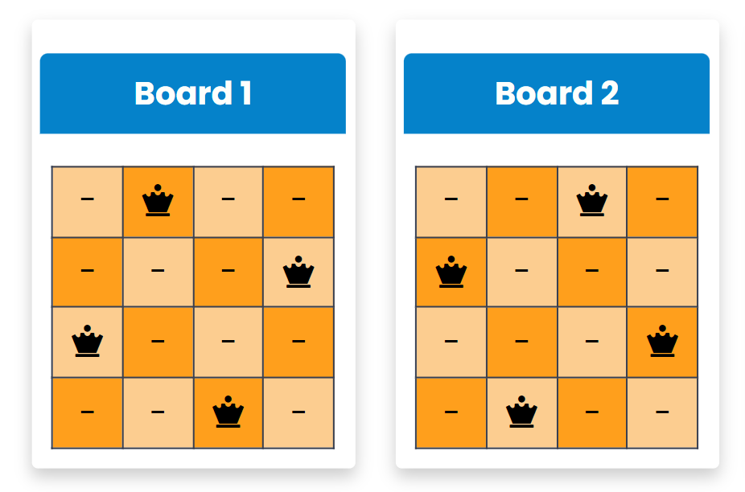
N-Queens Placement Visualizer
Interactive Chessboard
Step-by-Step Visualization
Explore Different Solutions
Users can input the number of queens (N) and visualize how they can be placed on the board.
The visualizer shows the backtracking process used to find valid queen placements.
Users can experiment with different values of N and see the various possible solutions.

Slide 8

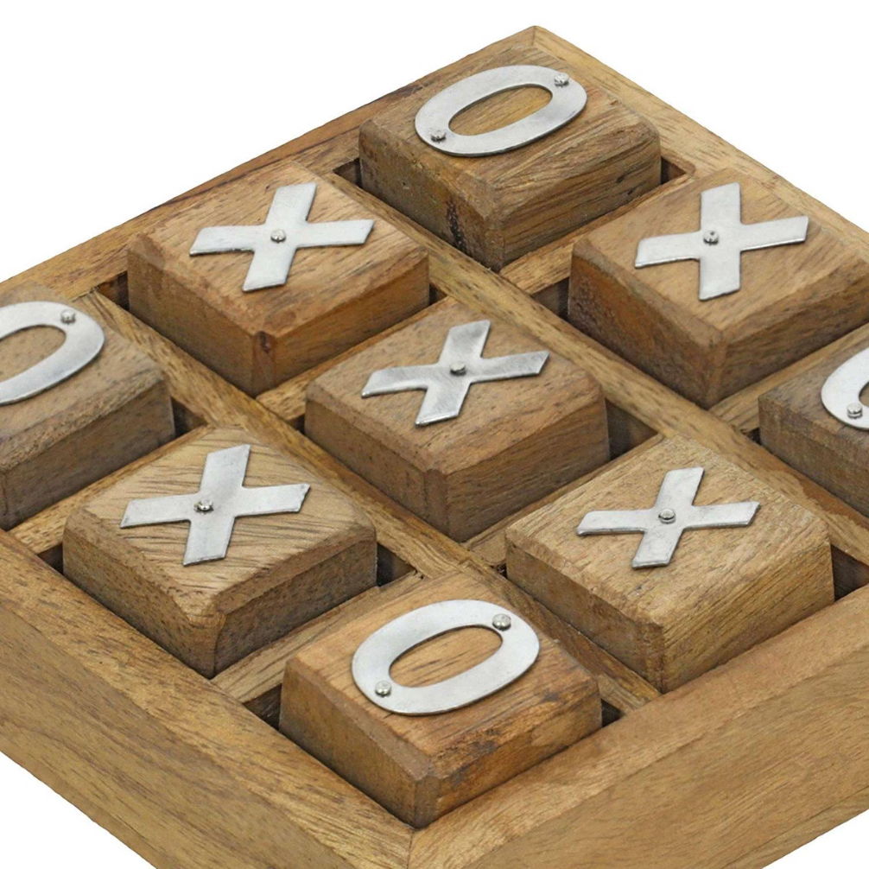
Tic-Tac-Toe Game
Two-Player Mode
Players can take turns placing X's and O's on the game board to try and get 3 in a row.

Slide 9
Algorithm
Initialize Game:
Player Move:
Set turn O = true for Player O to start and count = 0 to track moves. Define winning patterns.
On a box click: Mark "O" or "X" based on the current turn.
Disable the clicked box and increment count.
Check Win/Draw:
Reset Game
After each move, check if any win pattern is satisfied. If yes, display the winner and stop the game.
If count === 9 and no winner, declare a draw.
Clear boxes, re-enable input, and reset turnO and count for a new game.

Slide 10


Conclusion and Key Takeaways
1
Algorithmic Mastery
2
Interactive Learning
The project showcases the implementation of fundamental algorithms like backtracking and their practical applications.
The web-based visualizations and games provide an engaging learning experience for students and enthusiasts.
3
Real-World Relevance
The skills developed through this project are valuable for a wide range of software engineering and problem-solving tasks.

